Slide 1
Applied Data Science Capstone Project
Anastasia Falkovskaya April 13, 2020

Slide 2
Introduction
This is the Capstone Project for IBM Data Science Professional Certificate.
In this project, I will find the most pet friendly borough in Toronto.
Many people moving to a new neighbourhood will be concerned about how pet friendly the area is. My project aims to help people decide which area will be the most pet friendly.

Slide 3
Data source
Qualities that determine how pet friendly an area are the number of amenities for pets, such as “pet store”.
The more pet friendly amenities in the area, the more pet friendly the area is.
The source of the data for venues is foursquare, the latitude and longitude of Toronto neighbourhoods, and a list of Toronto neighbourhoods from wikipedia.

Slide 4
Methods
First, I latitude and longitude data was assigned to Toronto neighbourhoods.
Next, foursquare was used to find venue data for neighbourhoods.
Next, only data about pet stores was segmented.
K-means clustering was used to find which neighbourhoods have the highest occurrence of pet stores.

Slide 5
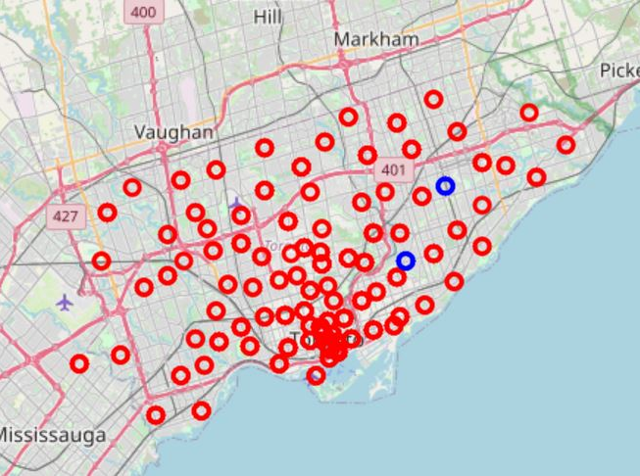
Results and Discussion
Most pet stores are around cluster 0, which are around Leaside, Willowdale, Studio District, St. James Town, Cabbagetown, Brockton, Parkdale Village, Exhibition Place, and India Bazaar, The Beaches West.

Slide 6
Conclusion
Because these neighbourhoods have amenities for pets, these would be a good place to move for people with pets.

